Slide 1
Bawdsey- 5.06.24- 7.06.24

Slide 2
Arrival at school
Enter into KS2 hall with all luggage
Medicines will be handed over to staff designated (male and female)
Children registered in classrooms
Leave 9:15am

Slide 3
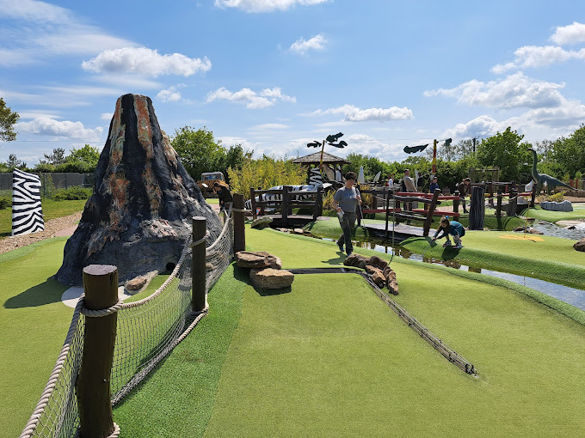
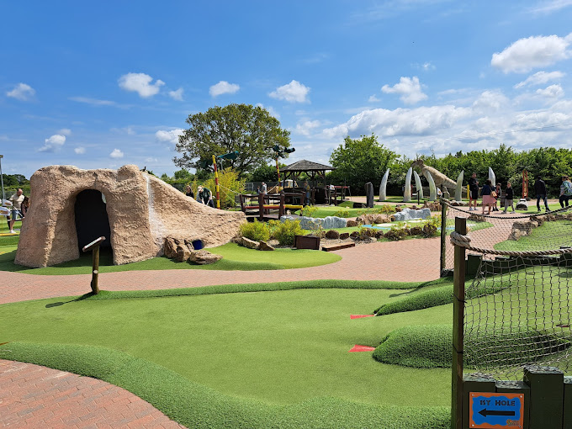
Crazy Golf

Slide 4
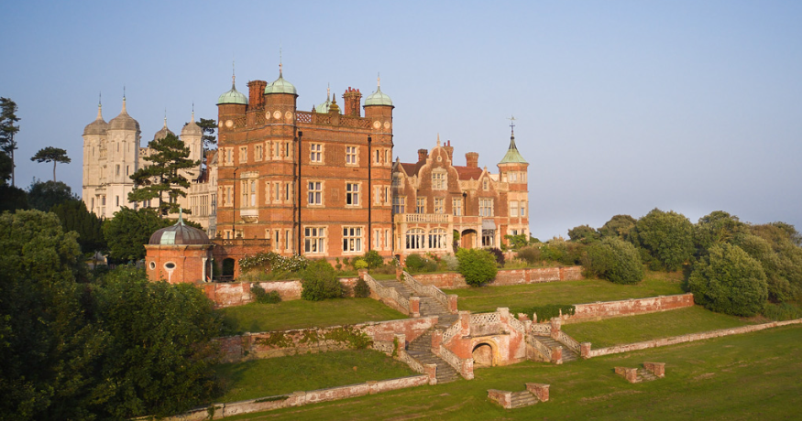
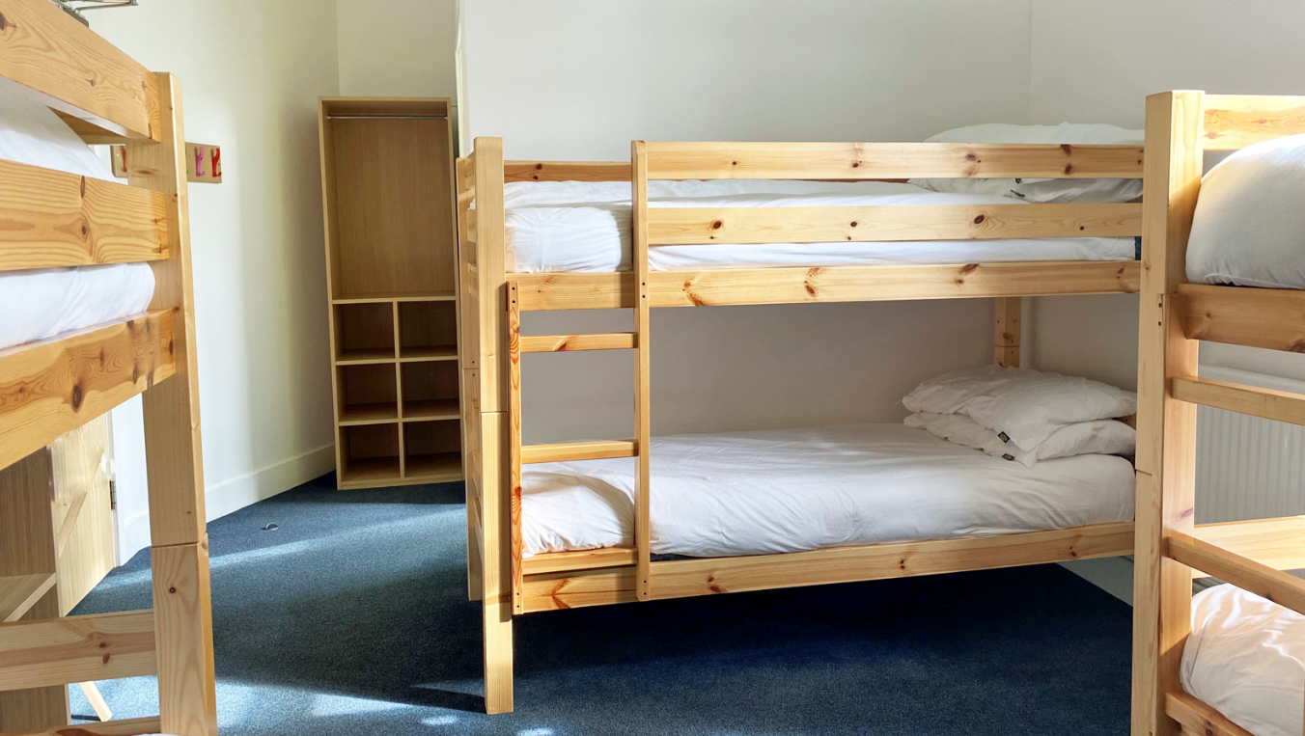
Bawdsey

Slide 5
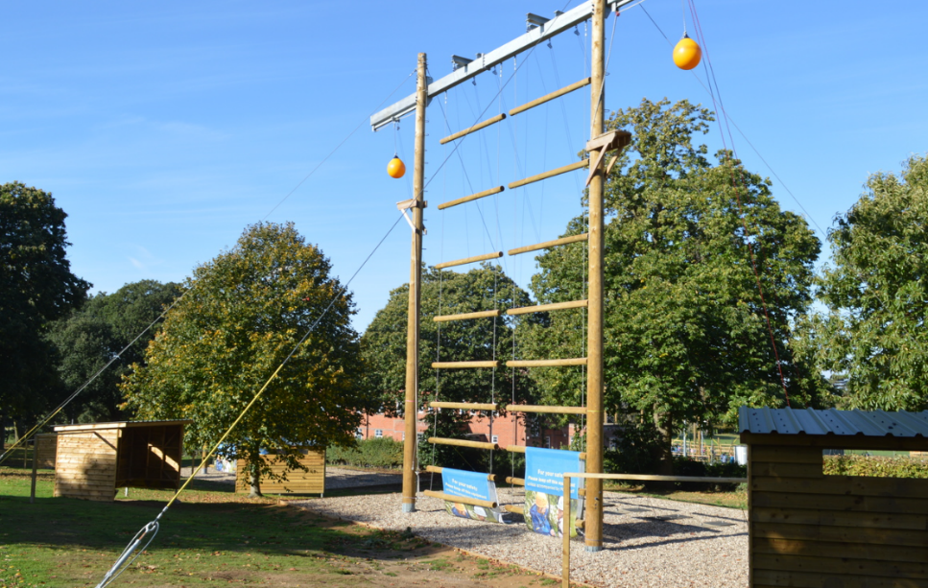
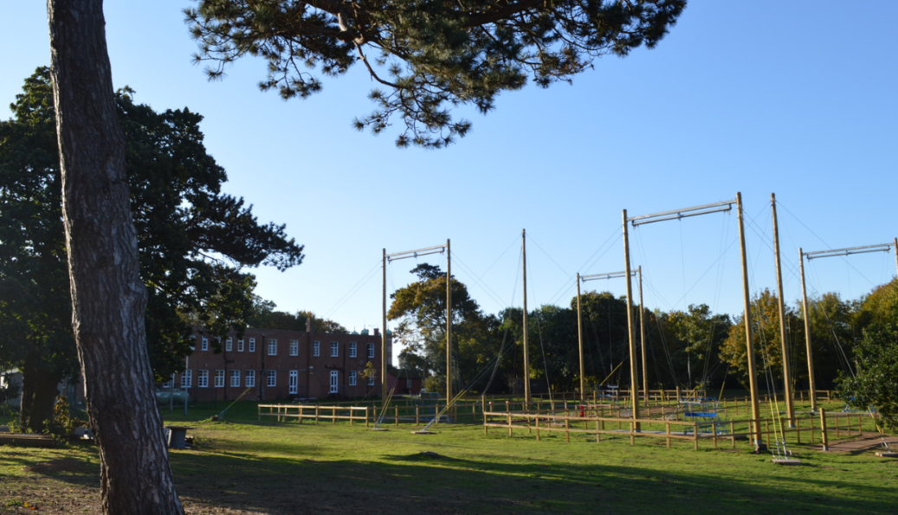
Activities
Climbing
Archery
Raft building- shoes (bin bag)
Giant swing
Jacob’s ladder
Sensory trail
Frisbee golf
Coastal walk

Slide 6
Daily Itinerary

Slide 7
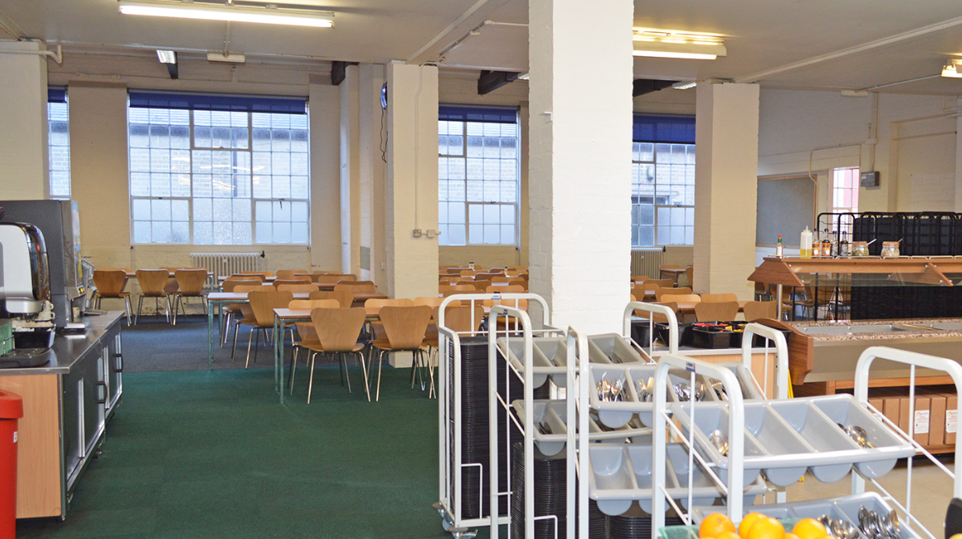
Food
UK PGL Menu - PGL Adventure Holidays
Last meal- lunch on Friday
Arrival home estimated: 3:00pm

Slide 8
Reminders
Appropriate clothing
Maximum £5.00 spending money for shop
Labelled water bottle with school name
No electronics
No phones
No spray deodorants
Suncream
Bags for dirty washing/ wet footwear
Bedding

